Slide 1
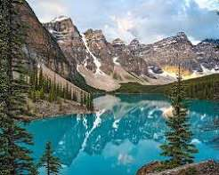
DATE
Brie
Citizenship 9
Insert some kind of cool picture here

Slide 2
TABLE OF CONTENTS
TABLE OF CONTENTS
WHERE
1
2
3
4
Personal
Community
Global
Aspirational

Slide 3
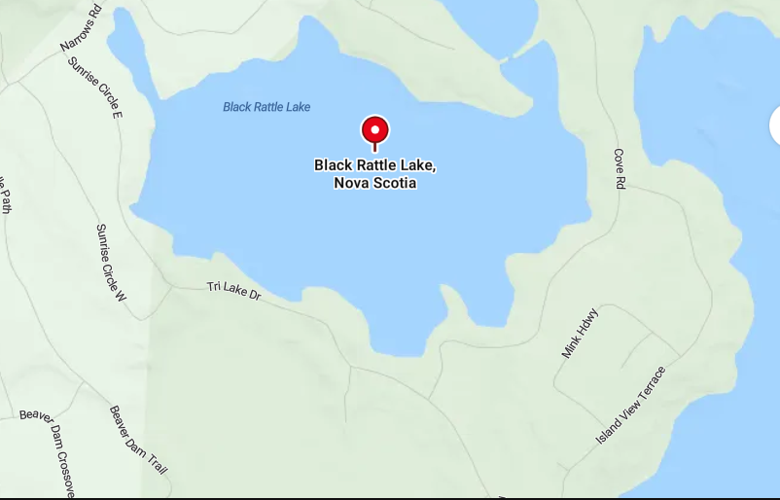
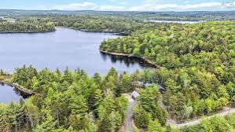
The Personal Place
Cit 9 WHERE
MAP SCREENSHOT (from Bing Maps) | My cottage on black rattle lake, that my family has been staying at every summer for 10+ years. I’ve spent so much time there with my cousins and family and have made so many memories here over the years. I don’t remember a time when I didn’t come here for a couple weeks in the summer, and it’s so nostalgic and sentimental to me. It’s a beautiful house on a lake and has lots of big open windows. I have thousands of memories from here and I’m sure to make many more. | IMAGE
Notes:
The Personal Place
Reflection: Write a paragraph about a personal place that holds significance for you.
Guiding Questions:: In a second section, describe how your personal perspective shapes the way you see and feel about this place. What stories or memories are tied to this specific location?

Slide 4
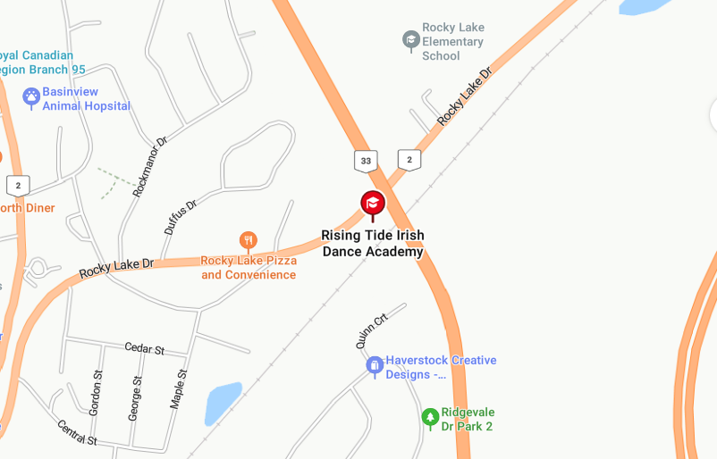
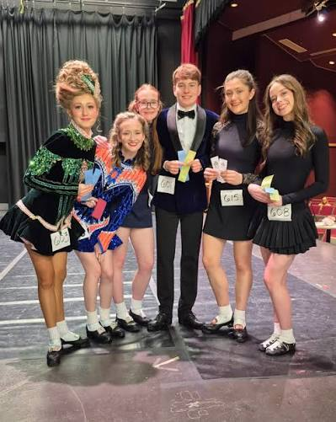
The Community Place
Cit 9 WHERE
MAP SCREENSHOT | My dance studio and all of the community that surrounds it. The studio really is my second home and I spend multiple hours a week there. My coaches are all so amazing and my classmates are all super supportive. Some of my best friendships were built up here, and I always feel my best self when I’m here. | IMAGE
Notes:
Reflection: Write about a significant place in our local community. Tell the story of the place! Who owns it? Why do you like it? Describe something that happened there that you remember.

Slide 5
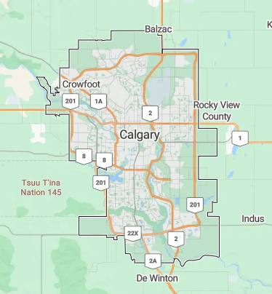
The Global Place
Cit 9 WHERE
MAP SCREENSHOT | Calgary hold so many memories and my favourite family members live there. I’ve been to Calgary many times now, some for dance competitions, and some for family trips. We went to a wedding there in August and it was super fun and the food was amazing. I also love seeing the kids who are 2 and 4. It’s super fun connecting with the part of my family who I don’t see as often. | IMAGE
Notes:
Reflection: Write a story about a place in the world that is part of your family's story.
Guiding Questions: Tell the story of how you and/or your family are connected to this place.
What traditions or values from this place have been passed down to you?
How does this connect to your cultural identity, including things you do and who you are?

Slide 6
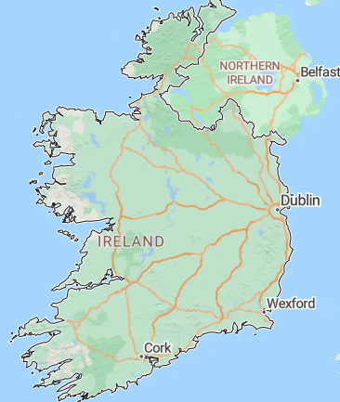
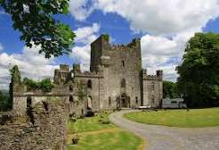
The Aspirational Place
Cit 9 WHERE
MAP SCREENSHOT | I would do anything to on a trip to Ireland. Doing Irish dancing has obviously connected me a lot with Irish culture and I think it would be such an amazing experience to go to Ireland one day. There is also a large chance that I could go because of dance, if I qualify for worlds, or just decide to go to a competition. I think Ireland is such a beautiful place and it would mean everything to me to be able to go. | IMAGE
Notes:
Reflection: Write a story about a place in the world that is part of your family's story.
Guiding Questions: What draws you to this place? What do you hope to learn or experience there? How does this place fit into your hopes for the future?

Slide 7

The Aspirational Place
Cit 9 WHERE
Soundtrack of your life | https://www.youtube.com/watch?v=nfWlot6h_JM | When I was a little kid, I was completely obsessed with Shake It Off by Taylor Swift. I would listen to it all the time and knew all the lyrics by heart from a young age. Now, I can play it on the drums, and even got Mr. Traill to let us play it in band!
Notes:
Reflection: Write a story about a place in the world that is part of your family's story.
Guiding Questions: What draws you to this place? What do you hope to learn or experience there? How does this place fit into your hopes for the future?

Slide 8
THANK YOU

